Slide 1

Houston TechFest
October 14 2017
Houston TX

Slide 2
Microservices and the Cloud
Shawn Weisfeld
Cloud Solution Architect
Microsoft

Slide 3
Session Objective
What is a Microservice? Functions? Service Fabric? Containers? Oh my! What are my options on hosting them in Azure? In this session we will boil it all down to an actionable roadmap that you can use to guide you on journey. We will then demonstrate their use in Azure.

Slide 4








About Me
Shawn Weisfeld
Cloud Solution Architect
Microsoft – One Commercial Partner Technical Team
sweisfel@microsoft.com
Austin, TX

Slide 5


Watch User Group presentations for FREE online! We now have over 700 presentations online
Miss a User Group meeting?
Forget something that you learned?
Want to see content from a User Group not in your area?
Want to share with a buddy?
Presentations from the thought leaders on the topics you care about including:
Agile
Azure
C#
Entity Framework
HTML5
MVC
SQL
jQuery
and Much More!
We know you cannot make it to every session,
that is why we post them online for you!
New Content added all the time!
For new content announcements
@UserGroupTV
http://www.UserGroup.tv

Slide 6
What is a Microservice?

Slide 7
Microservices
In computing, microservices is a software architecture style in which complex applications are composed of small, independent processes communicating with each other using language-agnostic APIs. These services are small building blocks, highly decoupled and focussed on doing a small task, facilitating a modular approach to system-building.
Source: https://en.wikipedia.org/wiki/Microservices

Slide 8
What is a Microservice
Microservice applications are composed of small, independently versioned, and scalable customer-focused services that communicate with each other over standard protocols with well-defined interfaces.
Does one thing well (functionality driven)
Is developed by a small cross-functional team
Can be built with task-appropriate languages/frameworks
Communicates over well-defined interfaces/protocols (lightweight)
Has a unique logical name (URI) that can be resolved
Is independent code and configuration (& optionally state)
Deploys independently
Scales independently
Gets upgraded independently
Monolithic application approach
Microservices application approach
1
App 1
3
App 1
App 2
2
4

Slide 9
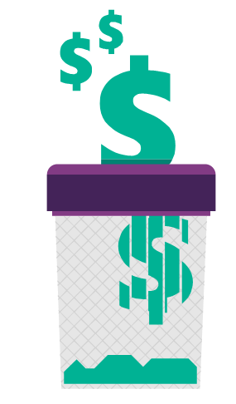
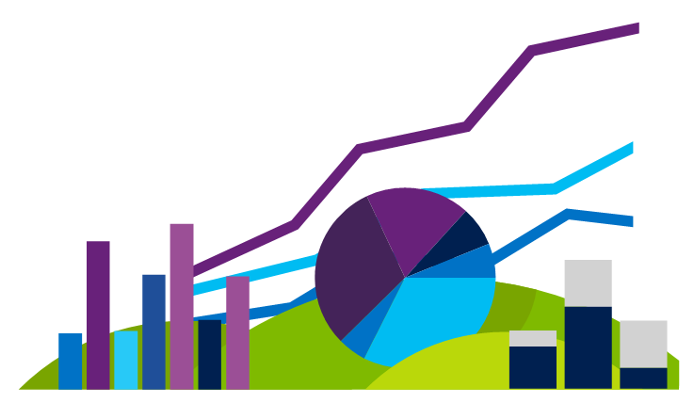

Business needs today are simple:
Scale – our applications are spanning many different servers and sometimes even multiple datacenters.
Agility – more frequent releases of incremental changes.
Availability – 24/7 operations with no downtime for upgrades, patches, etc.
Density – drive costs down by increasing the utilization of every asset.

Slide 10
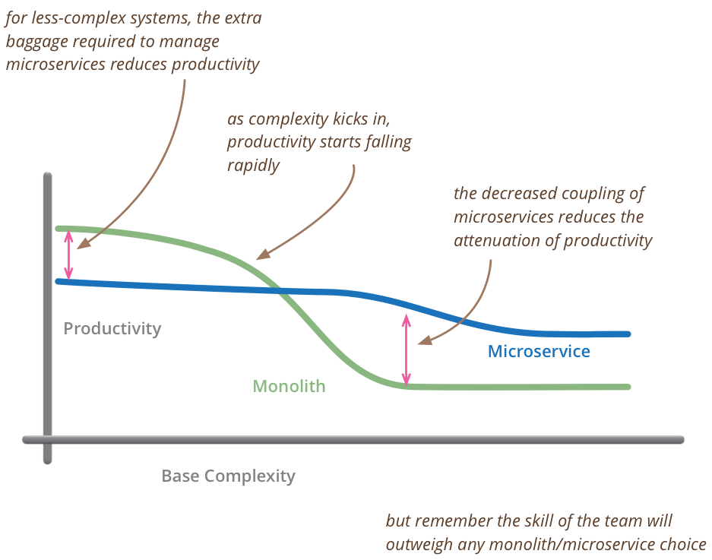
Martin Fowler’s “Microservice Premium”
“So my primary guideline would be don't even consider microservices unless you have a system that's too complex to manage as a monolith. The majority of software systems should be built as a single monolithic application. Do pay attention to good modularity within that monolith, but don't try to separate it into separate services.”
- Martin Fowler
https://martinfowler.com/bliki/MicroservicePremium.html

Slide 11









Microservices best practices
Macro-level insights
Determine if Microservices are needed
Put your house in order
Adopt a master artisan
Map to business processes
Move incrementally
Create a shared repository
Apply comprehensive monitoring
Improve security & governance
Reap the rewards
Source: https://techcrunch.com/2016/01/23/get-small-to-get-big-through-microservices/

Slide 12
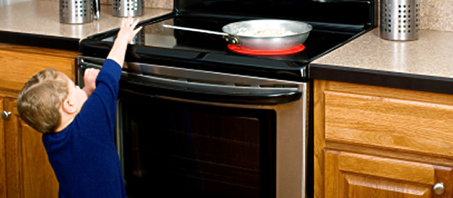
http://www.kazak.com/wordpress/wp-content/uploads/2014/07/child_stove.jpg

Slide 13
Getting from Monolith to Microservice

Slide 14
Refactoring a Monolith into Microservices
Stop digging
HTTP REQUEST
REQUEST ROUTER
Old HTTP requests
New HTTP requests
WEB
API
GLUE
CODE
GLUE
CODE
WEB
API
MONOLITH
SERVICE
Source: https://www.nginx.com/blog/refactoring-a-monolith-into-microservices/

Slide 15

Martin Fowler’s: Strangler Application

Slide 16
Refactoring a Monolith into Microservices
Split front-end and back-end
BROWSER
BROWSER
WEB APPLICATION
WEB APPLICATION
REST API
REST API
BUSINESS LOGIC
BUSINESS LOGIC
DATABASE
ADAPTER
DATABASE
ADAPTER
MYSQL
MYSQL
Source: https://www.nginx.com/blog/refactoring-a-monolith-into-microservices/

Slide 17
Refactoring a Monolith into Microservices
Extract services
WEB APPLICATION
WEB APPLICATION
REST API
REST API
REST CLIENT
REST API
BUSINESS LOGIC
BUSINESS LOGIC
BUSINESS LOGIC
BUSINESS LOGIC
MODULE X
MODULE Y
Step 1
MODULE X
MODULE Y
MODULE X
MODULE Z
MODULE Z
MODULE Y
MODULE Z
REST API
REST CLIENT
DATABASE
ADAPTER
DATABASE
ADAPTER
DATABASE
ADAPTER
DATABASE
ADAPTER
Step 2
MYSQL
MYSQL
MYSQL
MYSQL
Source: https://www.nginx.com/blog/refactoring-a-monolith-into-microservices/

Slide 18
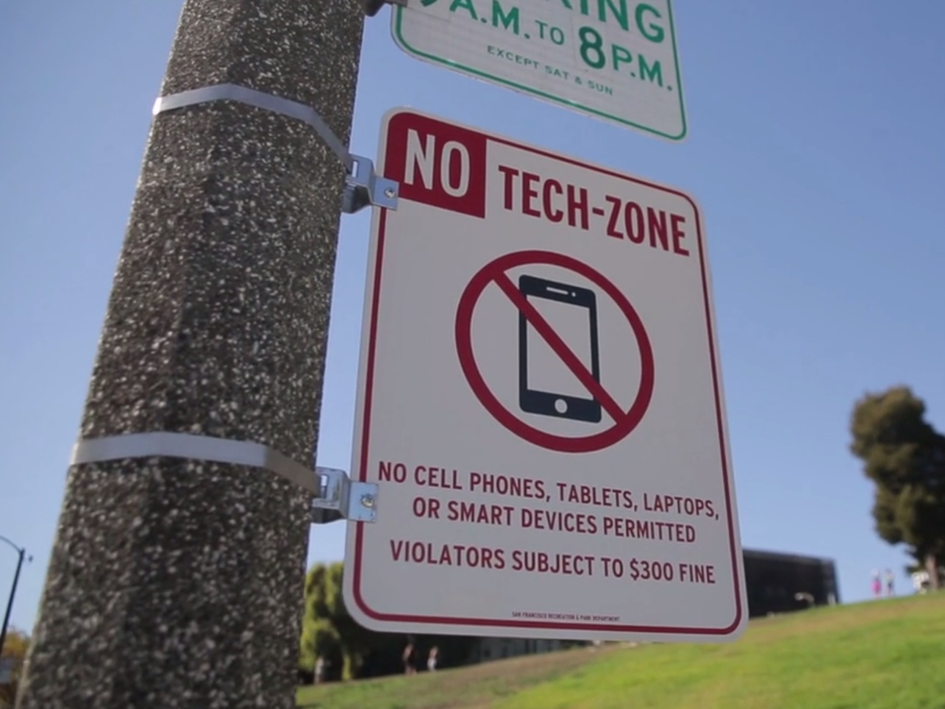
http://static1.businessinsider.com/image/5613135cbd86ef16008bf7db/a-former-facebook-employee-put-up-official-looking-no-tech-zone-signs-in-san-francisco-parks.jpg

Slide 19
Microservice Options in Azure

Slide 20
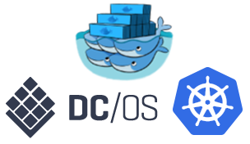

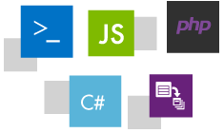
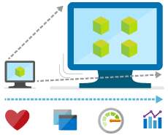
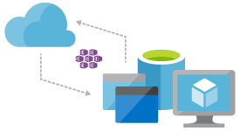
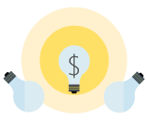
Microservice tools and approaches
Technical approaches
“Server-less”
Prescriptive framework
Bring your own
Quick ramp up, sub second metering, zero ops
Easy to build, deploy, and manage Microservices at scale
Customizable, pick best-of-breed solutions

Slide 21
Microservice tools and approaches
Azure solutions
Functions
Service Fabric
Container Services &
Container Instances
Platform optimized for developer productivity
Prescriptive platform for
hyperscale applications
Build your own
Developer productivity
Infrastructure control

Slide 22
Container Services & Container Instances

Slide 23
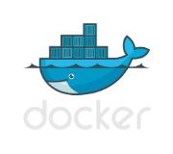



The Container Revolution
Standard image format for portability across environments
Virtual machine
VM-independence for efficiency, scalability, and resilience
Lightweight and agile for Cloud Native apps
Virtual machine +
Containers
Rich ecosystem of images with tools for development and operations

Slide 24
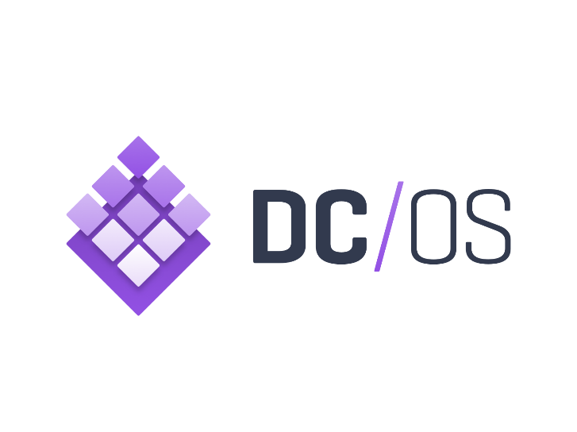


Azure Container Service
Choice of most popular container orchestrators
Simplest way to deploy containers on Azure
Few clicks to enterprise grade container solution
<`/>
Command Line Interface
ARM templates
Container Registry
Container
Monitoring
DC/OS
Swarm
Windows &
Linux Containers
*Managed disks for
persistent storage
Kubernetes
Azure Portal

Slide 25
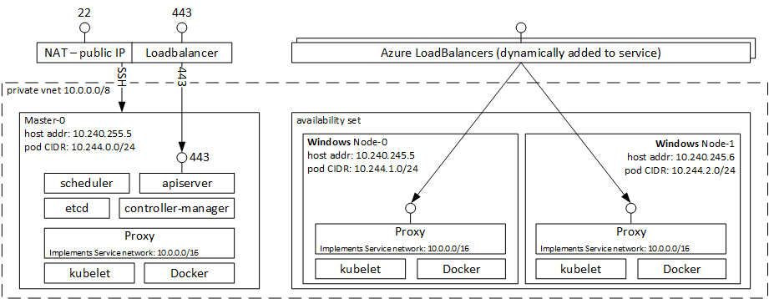
Demo: Kubernetes cluster in ACS
az group create --name=htfkubdemo --location=southcentralus
az acs create --orchestrator-type=kubernetes --resource-group=htfkubdemo --name=htfkubdemocluster --dns-prefix=htfkubdemo --generate-ssh-keys
https://docs.microsoft.com/en-us/azure/container-service/container-service-kubernetes-walkthrough
https://docs.microsoft.com/en-us/azure/container-service/container-service-kubernetes-windows-walkthrough

Slide 26
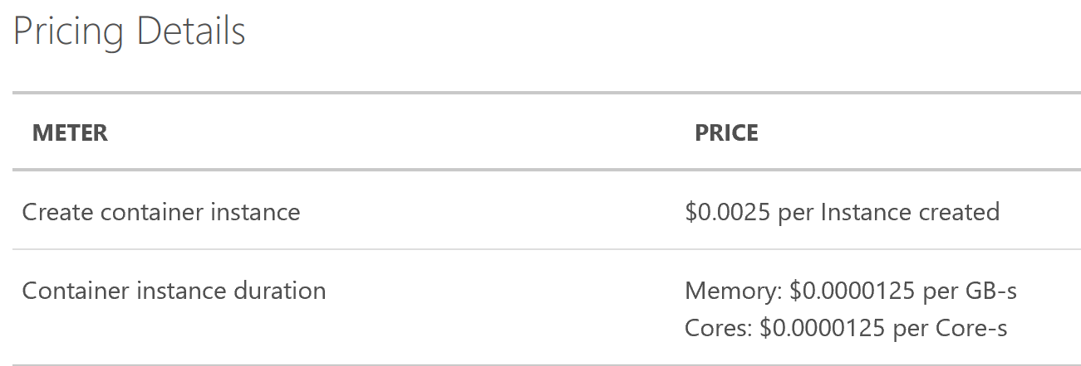
Azure Container Instances
Run your docker containers without overhead of VMs, orchestrators, etc.
Linux & Windows containers are supported
The container is an object in Azure.
ACI Connector for Kubernetes https://github.com/azure/aci-connector-k8s

Slide 27
Demo: Hello World in ACI
az group create --name aciDemoRG --location eastus
az container create --name helloworld --image microsoft/aci-helloworld --resource-group aciDemoRG --ip-address public
az container create --name websvr --image nginx --resource-group aciDemoRG --ip-address public
az container list –g aciDemoRG –o table
az container logs --name acidemocontainer --resource-group aciDemoRG
az group delete --name aciDemoRG --no-wait -y
https://docs.microsoft.com/en-us/azure/container-instances/container-instances-quickstart
https://channel9.msdn.com/Shows/Azure-Friday/Azure-Container-Instances

Slide 28
Service Fabric

Slide 29



Azure Service Fabric
Any OS, Any Cloud
Lifecycle
Management
Always On Availability
Programming Models
Health & Monitoring
Dev & Ops Tooling
Auto
scaling
Orchestration
Dev Box
Azure
On Premise
Other Clouds

Slide 30



Service Fabric Programming Models & CI/CD
Visual
Studio
&
VSTS
Jenkins
&
Eclipse
ASP.NET Core
Reliable Actors
Diagnostics & Monitoring
AppInsights
OMS
ELK
Reliable Services
Guest Executables
Containers
Lifecycle
Management
Auto
scaling
Lifecycle
Management
Always On Availability
Orchestration
Programming Models
Health & Monitoring
Dev & Ops Tooling
Auto
scaling
Dev Box
Azure
On Premise
Other Clouds

Slide 31




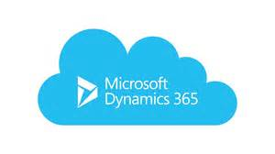



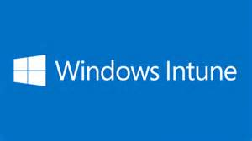
Services Powered by Service Fabric
Cosmos DB
Billions transactions/day
IoT Hub
Millions of messages
Event Hubs
60bn events/day
SQL Database
2.1 million DBs
30% of Azure cores run Service Fabric
Skype
Cortana
Intune
Dynamics
Power BI
Designed for mission critical tier 1 workloads

Slide 32
Demo
Web Service: This is a stateless front-end web service using ASP.NET Core in a Reliable Service.
Guest EXE Backend Service: This is a simple guest executable, a pre-compiled EXE that is packaged up and run on Service Fabric as-is.
Stateless Backend Service: This is a stateless back-end service using Service Remoting.
Stateful Backend Service: This is a stateful back-end service using ASP.NET Core, using Reliable Collections
Actor Backend Service: This is a back-end Reliable Actor service.
https://azure.microsoft.com/en-us/resources/samples/service-fabric-dotnet-getting-started/

Slide 33
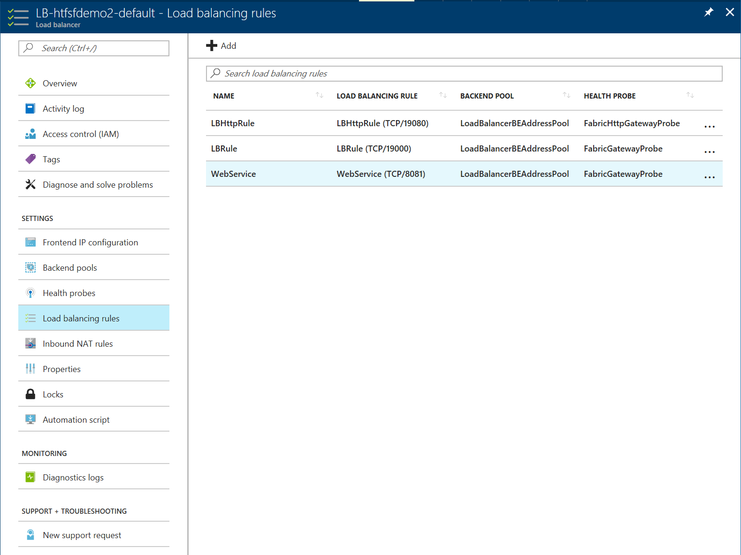
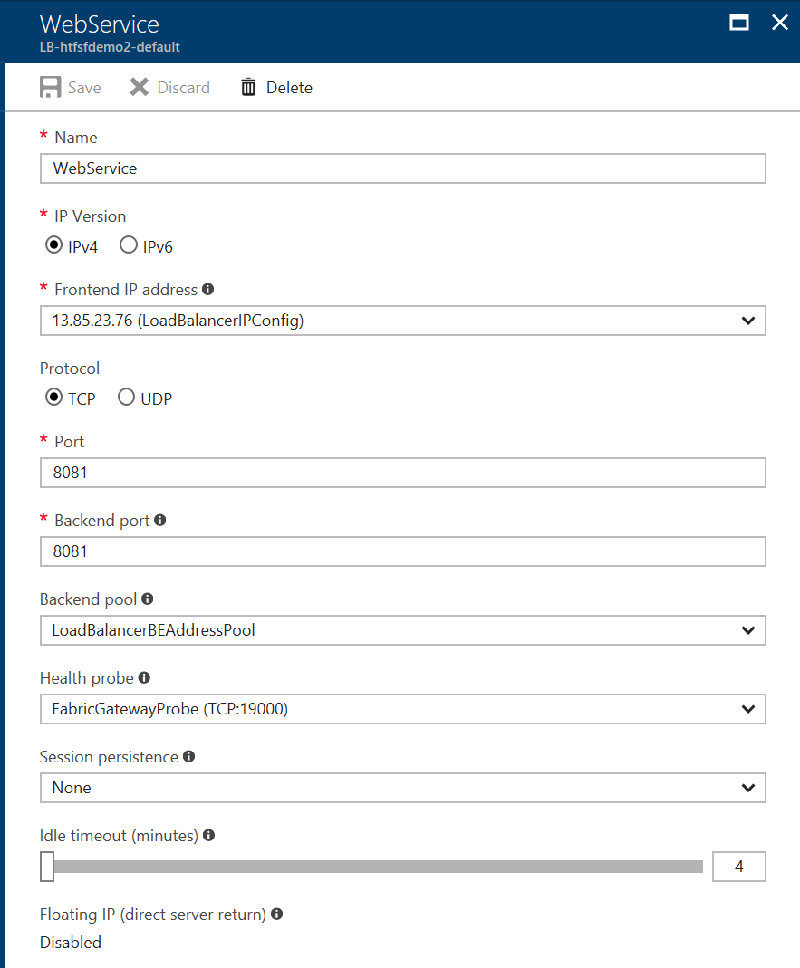
Demo Hints
Ensure that you create your cluster with the reverse proxy feature enabled.
Set up a Load Balancer rule to map port 8081 from the public IP to the backend nodes

Slide 34
Functions

Slide 35
What is Serverless?
$
Abstraction of servers
Event-driven/ instant scale
Micro-billing

Slide 36
Serverless is Great!
DevOps Productivity
Focus on business logic
Faster time to market

Slide 37
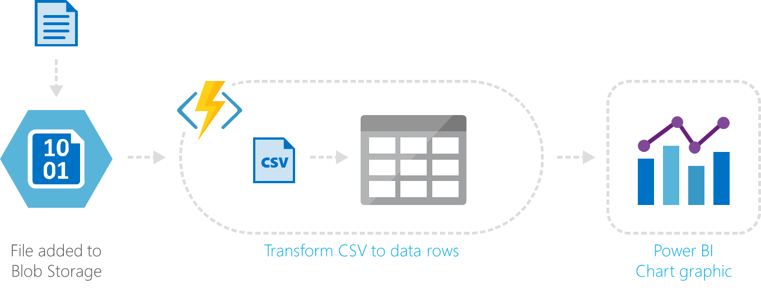
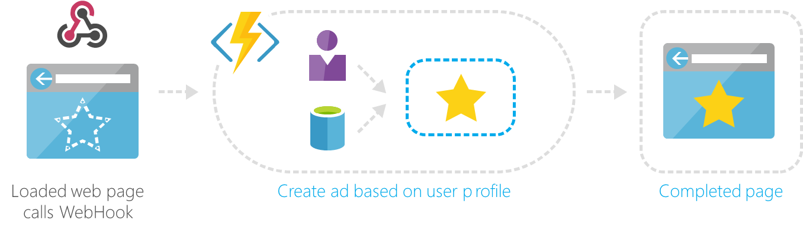
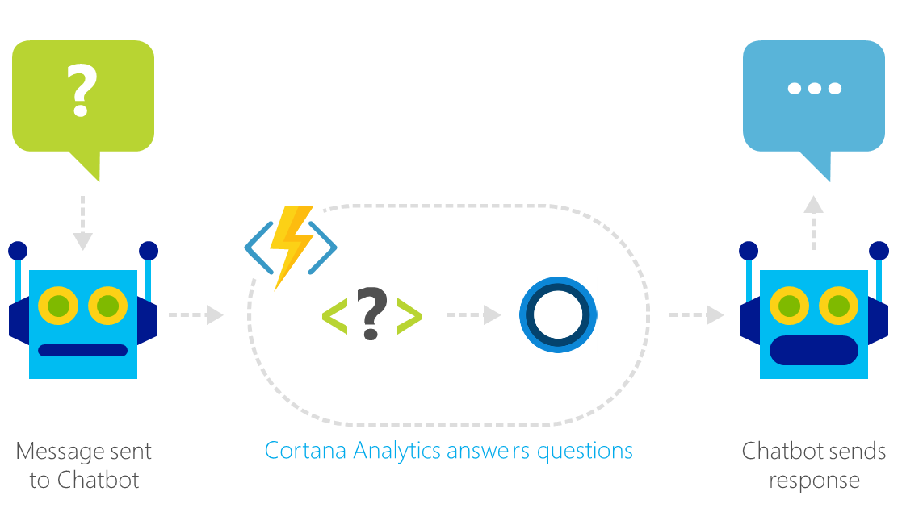
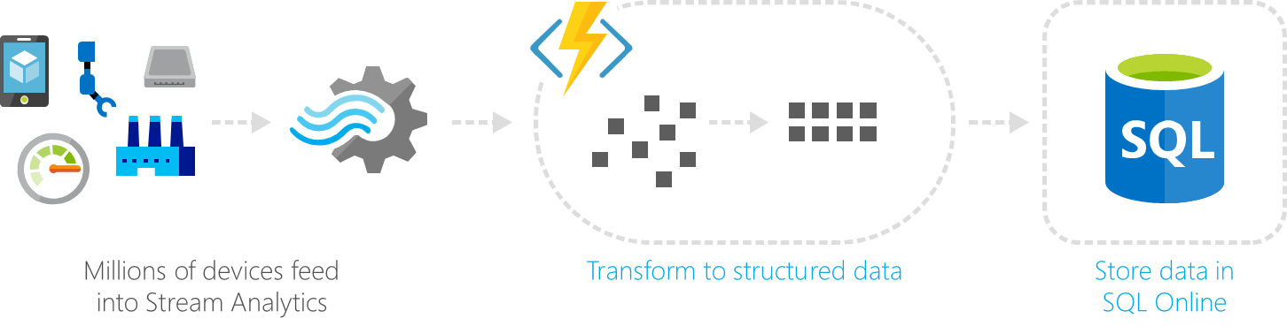
Common Scenarios
Web | Glue
Bots | IoT

Slide 38
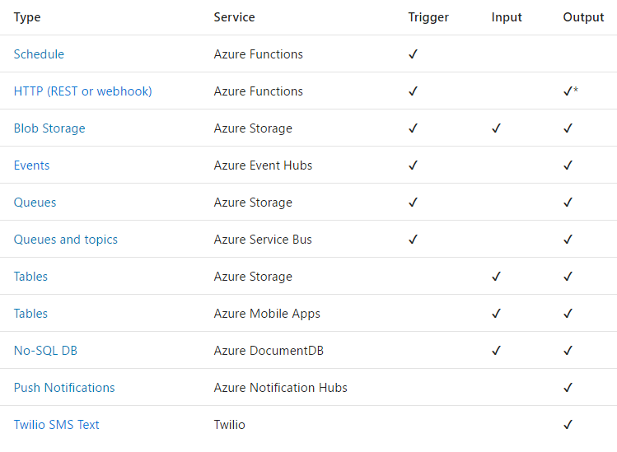
Triggers and Bindings
Triggers
and
Bindings

Slide 39
Demo
Simple http service

Slide 40
Wrap up

Slide 41
Deep thoughts…
Are Microservices right for you?
What technologies fit best for your team?
Do you want another slice of pizza?

Slide 42
Call to Action
Play with these services in Azure
Let us know what you think – http://feedback.azure.com
Evaluate workloads that you have that this would help with

Slide 43

Thank you! Your Feedback is Important
Rate My Talk & Download Slides!
http://bit.ly/RateShawnsTalk
(case sensitive)
Contact Information
Email: sweisfel@microsoft.com
Blog: http://www.shawnweisfeld.com
Twitter: @shawnweisfeld

Slide 44
Microservice Design patterns (technology agnostic)
Source:
https://dzone.com/articles/microservice-design-patterns
https://docs.microsoft.com/en-us/azure/architecture/patterns/

Slide 45
Aggregator/Proxy Microservice pattern
Load balancer
Service A
Cache
DB
Aggregator
Service B
Cache
DB
Service C
Cache
DB
Notes:
Aggregator would be a simple web page that invokes multiple services to achieve the functionality required by the application.
Proxy microservice design pattern is a variation of Aggregator. In this case, no aggregation needs to happen on the client but a different microservice may be invoked based upon the business need.

Slide 46
Chained Microservice pattern
Load balancer
Service A
Service B
Service C
Cache
DB
Cache
DB
Cache
DB
Notes:
Chained microservice design pattern produce a single consolidated response to the request. In this case, the request from the client is received by Service A, which is then communicating with Service B, which in turn may be communicating with Service C. All the services are likely using a synchronous HTTP request/response messaging.

Slide 47
Branch Microservice pattern
Load balancer
Service B
Cache
DB
Service A
Service C
Service D
Cache
DB
Cache
DB
Cache
DB
Notes:
Aggregator/proxy + Chain

Slide 48
Shared data Microservice anti-pattern
Load balancer
Service B
Cache
DB
Service A
Service C
Service D
Cache
DB
Cache
DB
Notes:
That means the service is full-stack and has control of all the components – UI, middleware, persistence, transaction.
Shared Data storage, typically an anti-pattern

Slide 49
Asynchronous messaging Microservice pattern
Load balancer
Service B
Proxy
Queue
Cache
DB
Service A
Service C
Service D
Cache
DB
Cache
DB
Cache
DB
Notes:
Use queues to remove synchronous calls.

Slide 50
Circuit Breaker
entry / reset failure counter
do / if operations succeeds return result
else
increment failure counter
return failure
exit /
Closed
SUCCESS COUNT THRESHOLD REACHED
FAILURE THRESHOLD REACHED
entry / reset failure counter
do / if operations succeeds increment success counter return result
else
return failure
exit /
Half-open
entry / start timeout timer
do / return failure
exit /
Open
TIMEOUT TIMER EXPIRED
OPERATION FAILED
Notes:
calls to remote resources and services can fail due to transient faults
The Circuit Breaker pattern can prevent an application from repeatedly trying to execute an operation that's likely to fail.
https://docs.microsoft.com/en-us/azure/architecture/patterns/circuit-breaker

Slide 51
Compensating Transaction
OPERATION STEPS TO CREATE ITINERARY
Book seat on flight F1
Book seat on flight F2
Book seat on flight F3
Reserve room at hotel H1
Reserve room at hotel H2
Cancel seat on flight F1
Cancel seat on flight F2
Cancel seat on flight F3
Cancel room at hotel H1
Cancel room at hotel H2
Compensating logic
Compensating logic
Compensating logic
Compensating logic
Compensating logic
COMPENSATING TRANSACTION TO CANCEL ITINERARY
Notes:
As the original operation proceeds, the system records information about each step and how the work performed by that step can be undone. If the operation fails at any point, the workflow rewinds back through the steps it's completed and performs the work that reverses each step.
https://docs.microsoft.com/en-us/azure/architecture/patterns/compensating-transaction

Slide 52

Scheduler Agent Supervisor
10 01
AGENT
REMOTE RESOURCE
SCHEDULER
AGENT
REMOTE SERVICE
STATE STORE
SUPERVISOR
Notes:
The Scheduler arranges for the steps that make up the task to be executed and orchestrates their operation.
The Agent contains logic that encapsulates a call to a remote service, or access to a remote resource referenced by a step in a task.
The Supervisor monitors the status of the steps in the task being performed by the Scheduler.
https://docs.microsoft.com/en-us/azure/architecture/patterns/scheduler-agent-supervisor

Slide 53
Retry
1
500
2
500
3
APPLICATION
HOSTED SERVICE
200
Notes:
https://docs.microsoft.com/en-us/azure/architecture/patterns/retry

Slide 54
Leader Election
1
4
3
BlobDistributedMutex
10 01
BlobDistributedMutex
BLOB
SUBORDINATE ROLE INSTANCES
2
BlobDistributedMutex
Notes:
Coordinate the actions performed by a collection of collaborating instances in a distributed application by electing one instance as the leader that assumes responsibility for managing the others.
https://docs.microsoft.com/en-us/azure/architecture/patterns/leader-election

